Slide 1
Recharge your Health:
Upgrade your Sleep.
Supercharge your Lifestyle.
Sleep, Health, & Lifestyle Analysis
DATA 225 Group 4
Chelsea Jaculina, Manjot Singh, Prasad Sai Thalluri
May 8, 2024
Notes:
Sai - 1 2 3 8 9
Chelsea - 4 5 12 13
Manjot - 6 7 10

Slide 2
OVERVIEW
INTRODUCTION
MOTIVATION
TOOLS & TECHNOLOGY STACK
DATABASE DESIGN : E-R DIAGRAM
WORKFLOW
DEMO
DATA VISUALIZATION
LESSONS LEARNED
TECHNICAL DIFFICULTIES
CONCLUSION
FUTURE WORK
Q & A

Slide 3
INTRODUCTION
The goal of the Sleep Health and Lifestyle Analysis Database Project is to comprehend how sleep patterns and health outcomes are related.
The study intends to find patterns and connections that might guide treatments and encourage healthy sleep habits.
Features include:
Gender, Age, Occupation
Sleep Duration, Quality of Sleep
Physical Activity Level, Stress Levels
BMI Category, Blood Pressure, Heart Rate, Daily Steps
Presence or Absence of Sleep Disorders

Slide 4
MOTIVATION
Getting enough quality sleep is essential for your overall health and well-being.
Our analysis aims to identify factors influencing sleep quality and provide insights for improving sleep habits.
Evaluating sleep patterns and their correlations with various factors will help draw conclusions and provide recommendations to create a well-balanced lifestyle.
Notes:
Purpose:

Slide 5
TOOLS & TECHNOLOGY STACK
Data Source - Kaggle
Data Modeling Techniques – mySQL Workbench E-R Diagram
DB Connectivity – Python to MySql
Code Standard – Python, SQL
ETL Tool – Google BigQuery
Data Visualization – Seaborn, Looker
Database – MySQL, MongoDB
Data Warehouse – Google BigQuery
Version Control – Github
Practiced Agile / Scrum – Trello, Google Meets, Lucidchart

Slide 6
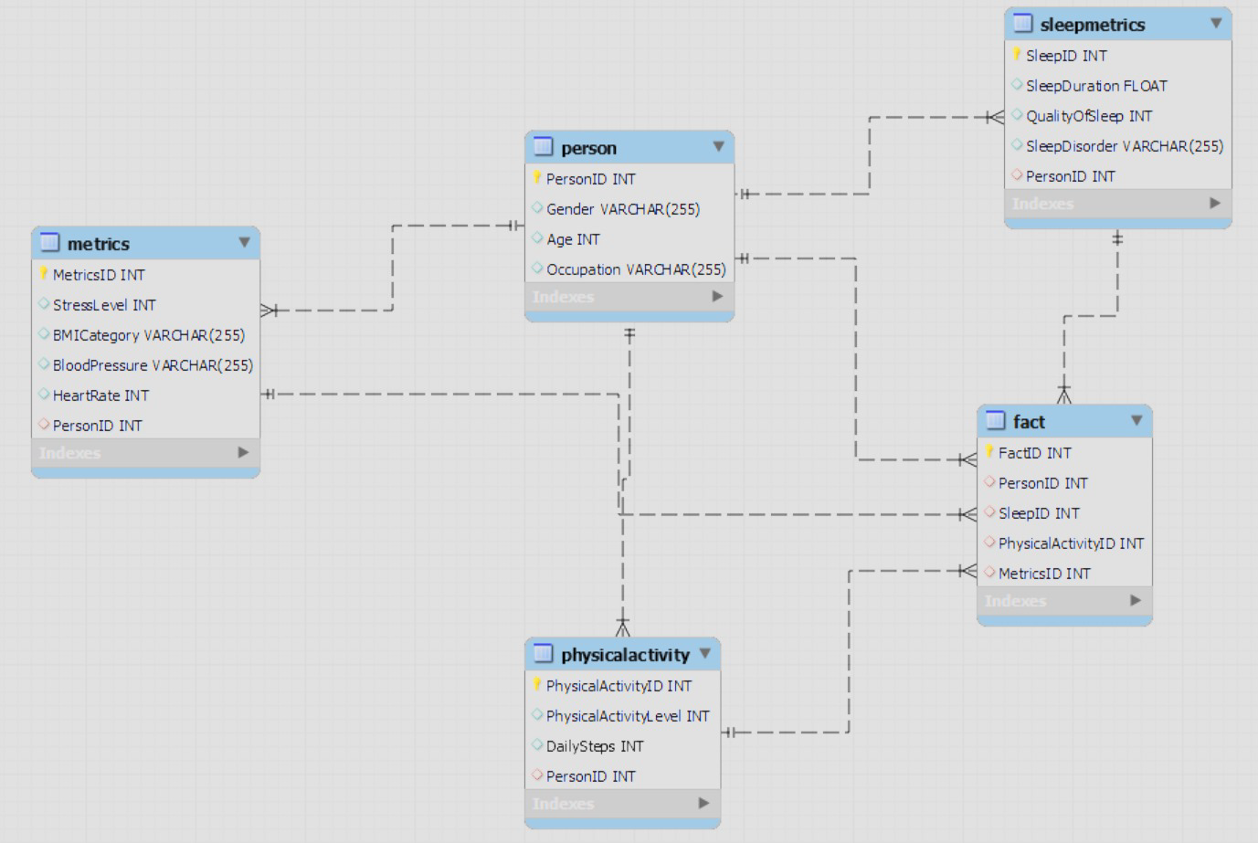
DATABASE DESIGN CONCEPT - ER DIAGRAM
Notes:
ER Diagram using mySQL workbench
Fact Table
4 Dimension Tables
SleepMetrics
Person
PhysicalActivity
Metrics

Slide 7
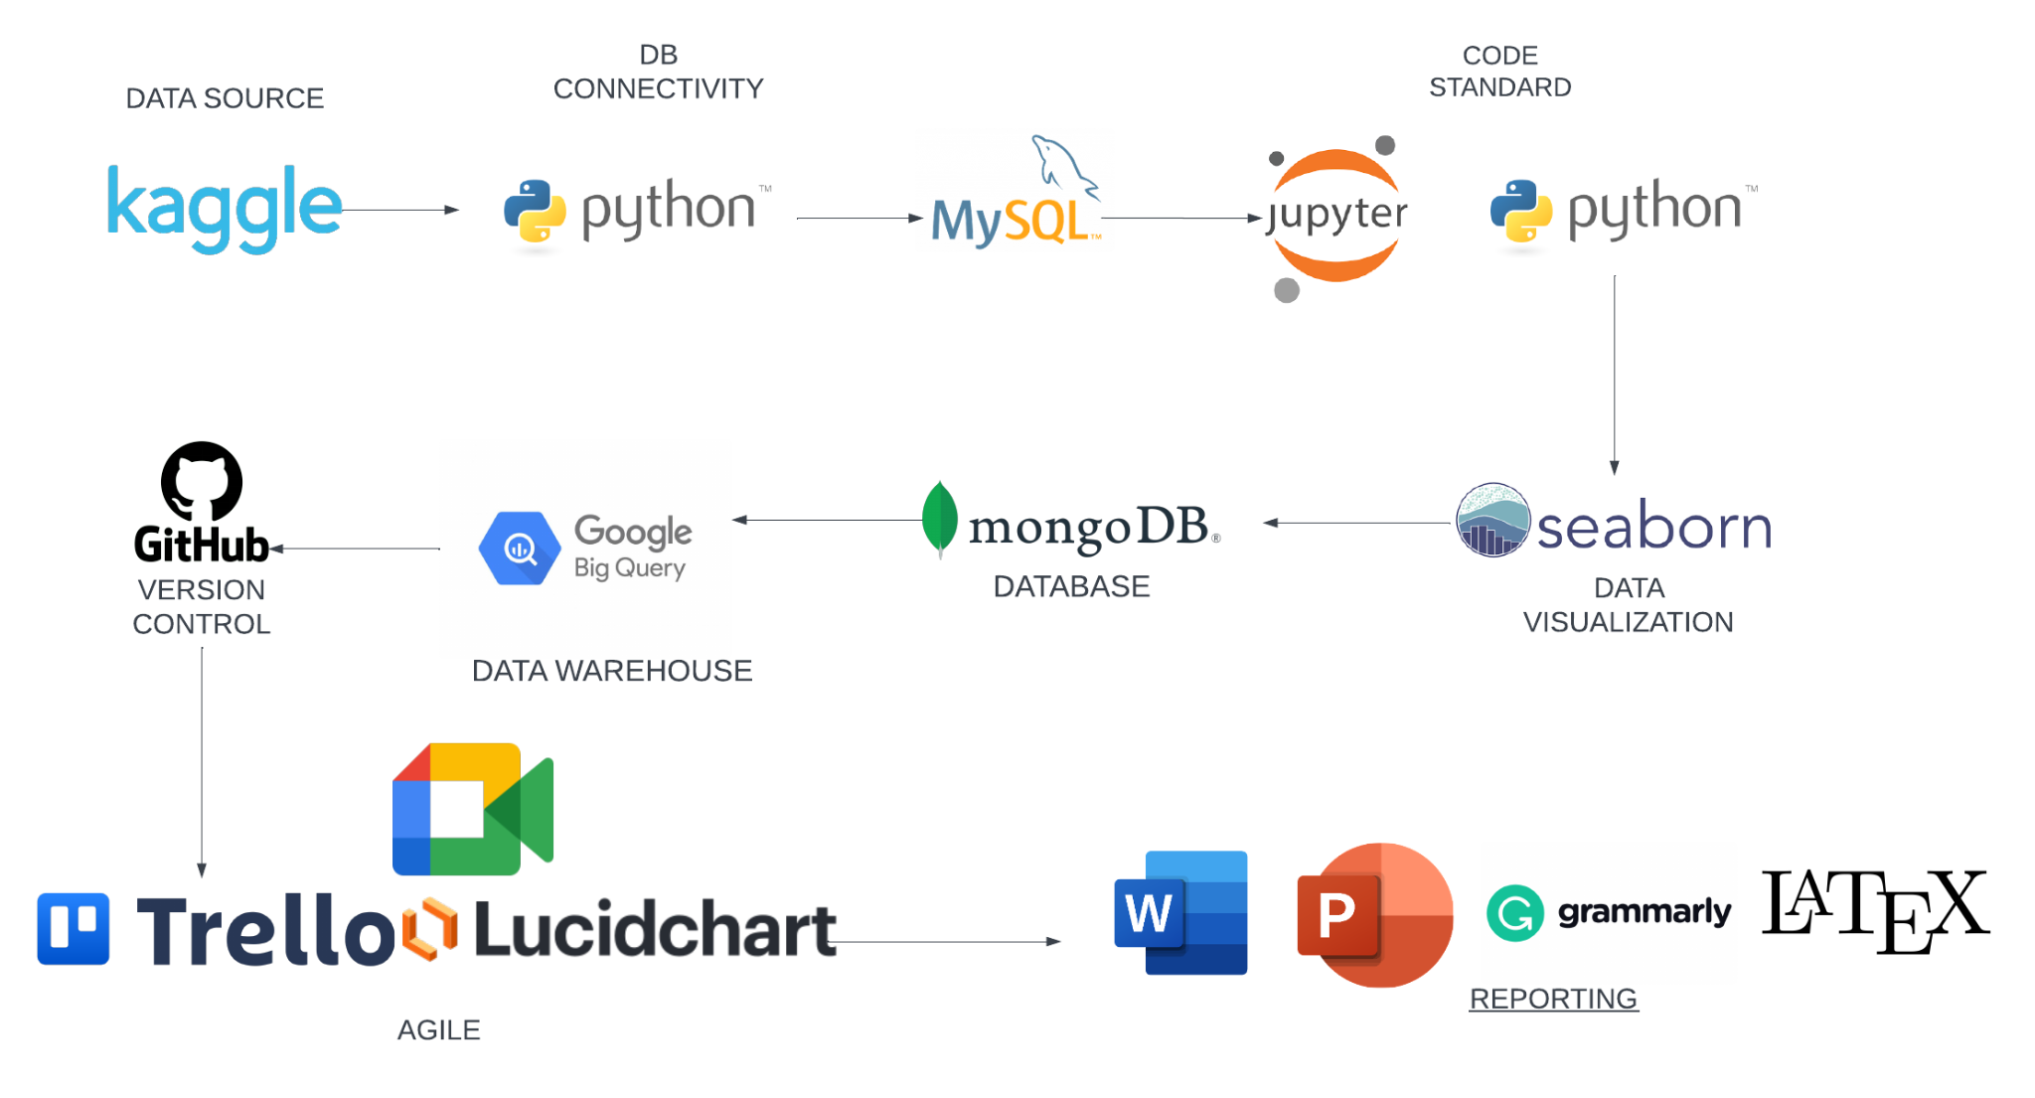
WORKFLOW
Notes:
How did we load the data?
How did we connect our Kaggle dataset?
How we did perform ETL?
How did we perform visualizations?
What are your pipelines?
What was the most challenging part?
Key takeaways?

Slide 8
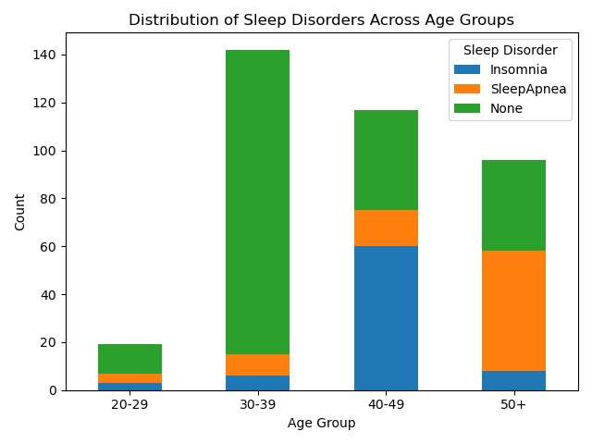
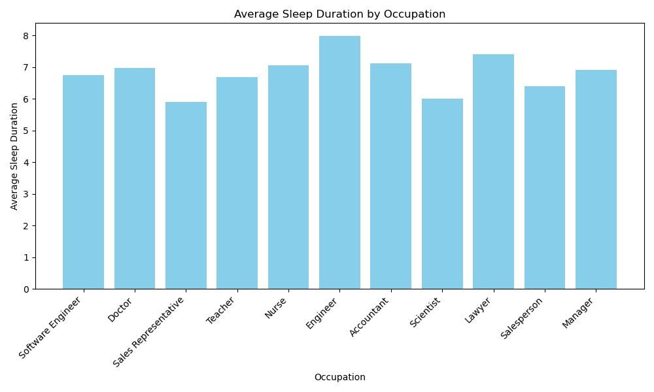
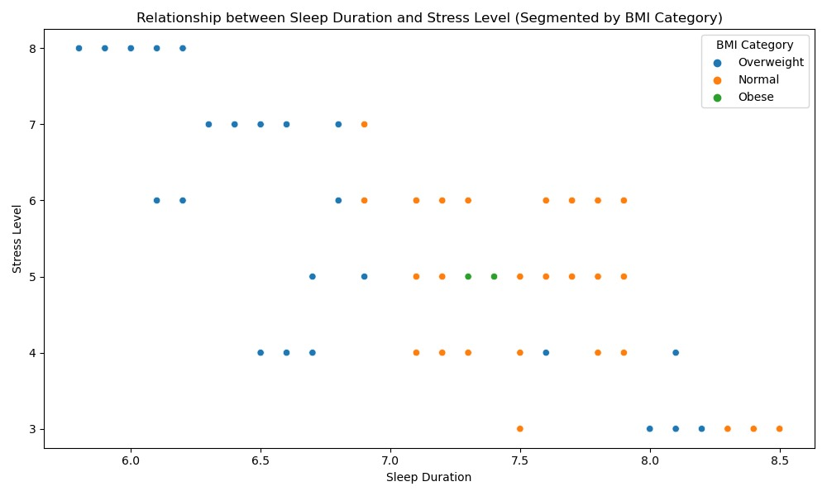
DATA VISUALIZATIONS
Distribution of Sleep Duration by Age Groups
Average Sleep Duration by Profession
Relationship Between Sleep Duration & Stress Level by BMI

Slide 9
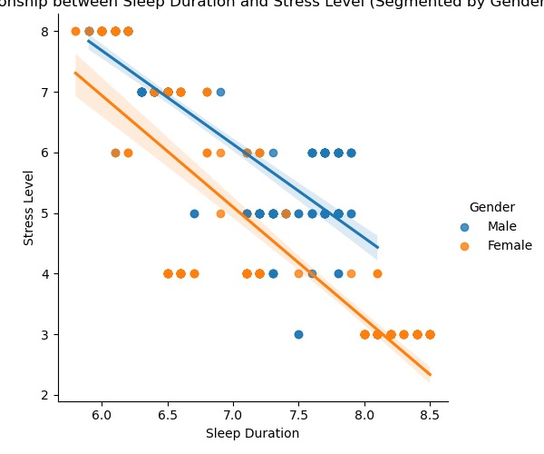
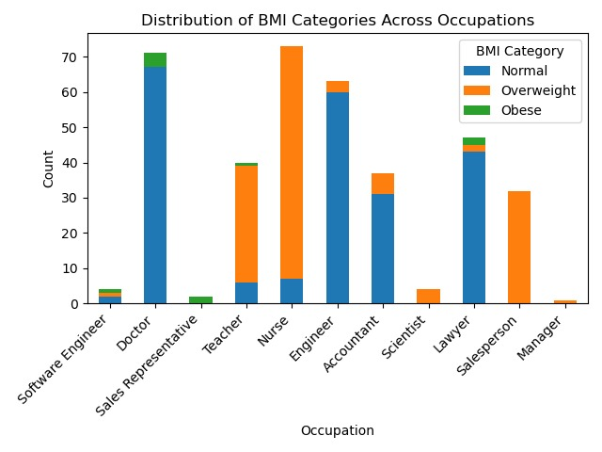
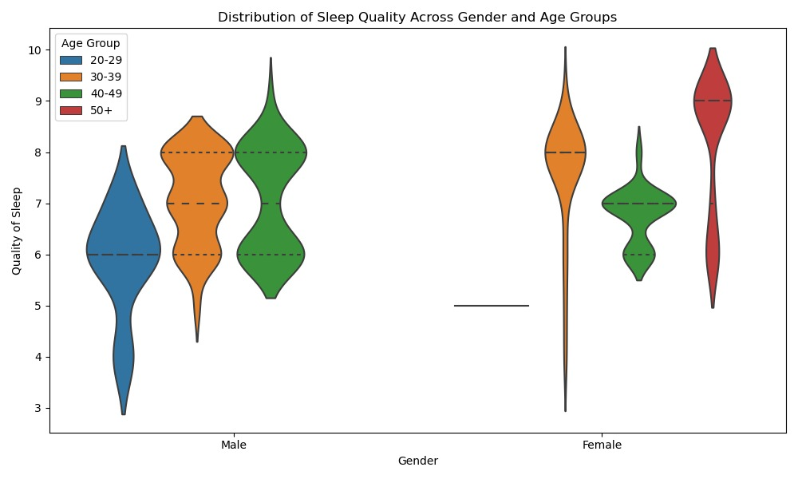
DATA VISUALIZATIONS
Relationship Between Sleep Duration & Stress Level by Gender
Distribution of BMI Categories by Profession
Distribution of Sleep Quality by Gender and Age Groups

Slide 10

DEMO
Notes:
Data Cleaning
ETL
Analytical Queries
Visualization
NoSQL
MongoDB
Data Source - Kaggle
Data Modeling Techniques – mySQL workbench Entity-Relationship Diagram
DB Connectivity – Python to MySql
Data Cleaning
Code Standard – Python, SQL
ETL Tool – Google Big Query
Data Visualization – Seaborn
Database – MySQL, MongoDB
Data Warehouse – Google BigQuery
Version Control – Github
Practiced Agile / Scrum – Trello, Google Meets, Lucidchart
DEMOS
Seaborn Data Visualization
Mongo DB Database
Google Big Query Data Warehouse

Slide 11
KEY LEARNINGS
Leveraged MySQL Workbench for E-R diagrams to ensure efficient data organization and relationships.
Overleaf LaTeX editor have multiple IEEE templates which helped in project report creation.
We also got to know the working and implementation of MongoDB database and Google BigQuery Data Warehouse tool.
Google BigQuery serves as a powerful ETL and data warehouse tool, offering scalability and efficiency in extracting, transforming and loading large amounts of data.
Embraced Agile/Scrum methodologies using Trello for task management to enhance team collaboration

Slide 12
TECHNICAL DIFFICULTIES
Throughout the project, we came across many challenges. Few of the notable ones are:
After normalizing the data using python, it was challenging to create the foreign key references for the tables using SQL.
Using new tools like Google BigQuery and Looker Studio created minor issues.

Slide 13
CONCLUSION
This project examines the relationships between sleep duration, quality of sleep, and sleep order, with metrics such as occupation, gender, and BMI category.
Analyzing these variables, allowed us to gain insights and make connections between sleep patterns and factors such as their professional roles, BMI, and gender.

Slide 14
THANK YOU!
Questions?

